Slide 1
Data Science Workflow Part 2

Slide 2
Agenda
Turn raw tweets into model-ready data using a structured workflow.
Build a sentiment classifier using a BiLSTM deep learning model.
Evaluate the model with accuracy, precision, recall, F1-score and a confusion matrix.
Save the trained model and deploy it as a web app using Streamlit.
Understand how a real end-to-end data science project is executed in practice.

Slide 3
Problem Statement – Twitter Sentiment
We have tweets labelled as negative, neutral, or positive.
Goal: Build a model that predicts sentiment for a new tweet.
Use this as a mini case study to practice text preprocessing, deep learning for NLP, model evaluation and deployment.

Slide 4
End-to-End Workflow
Dataset Overview – understand Twitter_Data.csv.
NLP Preprocessing – clean_text() and label encoding.
Train/Test Split – stratified sampling.
Tokenization & Padding – Keras Tokenizer and pad_sequences.
Deep Learning Model – BiLSTM sentiment classifier.
Model Evaluation – metrics & confusion matrix.
Model Saving & Deployment – sentiment_model.h5 and Streamlit app.

Slide 5
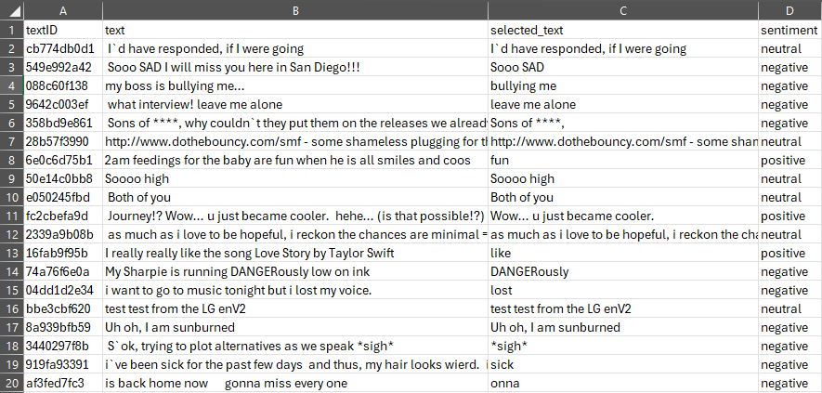
Dataset Overview – Raw Twitter Data
We start from Twitter_Data.csv containing raw labelled tweets.

Slide 6
Exploratory View – Labels and Lengths
Check class balance for the sentiment column using value_counts().
Inspect text length distribution (characters or tokens) to understand tweet sizes.
Dataset is reasonably balanced across the three classes – suitable for supervised learning.
Tweets are short, so a fixed sequence length (e.g., 40 tokens) is sufficient.

Slide 7
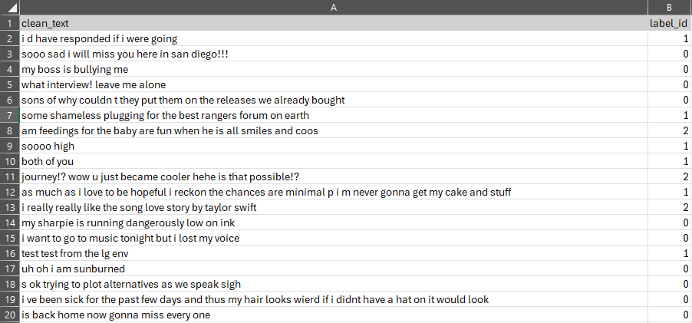
Dataset Overview – After Preprocessing
After cleaning we create a new DataFrame with the key columns: text, clean_text, sentiment, label_id.

Slide 8
NLP Preprocessing – clean_text() and Labels
Define clean_text(text) using regular expressions: remove URLs and @mentions,
keep only letters, spaces, exclamation and question marks, lowercase and collapse spaces.
Map sentiment strings to numeric label_id: 0 = negative, 1 = neutral, 2 = positive.
Drop very short cleaned tweets (length ≤ 2) to reduce noise.
The same clean_text() function is reused later inside the Streamlit app.

Slide 9
Train–Test Split
Features X: clean_text column (strings).
Labels y: label_id column (integer encoded sentiments).
Use train_test_split from scikit-learn with test_size = 0.2 and stratify = y.
Result: ~80% tweets for training, ~20% tweets for final evaluation.

Slide 10
Tokenization and Sequence Padding
Create Tokenizer(num_words=20000, oov_token="<OOV>") from Keras.
Fit the tokenizer only on training texts X_train.
Convert texts to sequences of integer word IDs using texts_to_sequences().
Pad or truncate to a fixed length of 40 tokens using pad_sequences().
Outputs: X_train_pad and X_test_pad with shapes (n_samples, 40).

Slide 11
BiLSTM Model for Sentiment Classification
Embedding layer: input_dim=20000, output_dim=100, input_length=40.
SpatialDropout1D(0.1) for regularisation.
Bidirectional LSTM with 128 units to capture context from both directions.
Dense(64, activation='relu') followed by Dropout(0.3).
Output layer: Dense(3, activation='softmax') for negative, neutral and positive.
Loss: sparse_categorical_crossentropy, Optimizer: Adam, Metric: accuracy.

Slide 12
Handling Under-Predicted Classes – Class Weights
Baseline model tended to under-predict the 'negative' class.
Compute class weights with compute_class_weight(class_weight='balanced', ...).
Use class_weight=class_weight_dict when calling model.fit().
This increases the penalty for misclassifying minority/ignored classes.
Result: the model learns to pay attention to all three sentiments.

Slide 13
Training the BiLSTM Model
Inputs: X_train_pad (padded sequences) and y_train (integer labels).
Validation data: (X_test_pad, y_test).
Epochs: up to 15, Batch size: 32.
EarlyStopping callback monitors val_loss with patience=2 and restore_best_weights=True.
Training stops automatically when validation loss stops improving.

Slide 14
Model Evaluation – Metrics
Predict on the test set: y_pred = argmax(model.predict(X_test_pad), axis=1).
Use classification_report to compute precision, recall and F1-score per class.
Compute overall accuracy on the held-out test set.
Create a confusion matrix to see where classes are confused (rows = true, columns = predicted).
Discuss how well the model separates negative, neutral and positive tweets.

Slide 15
Error Analysis – Understanding Mistakes
Inspect some tweets where the model’s prediction differs from the true label.
Typical sources of error: sarcasm, irony, very short tweets and ambiguous language.
Discuss which classes are hardest to predict and why.
Brainstorm potential improvements: more data, pre-trained embeddings, transformer models, etc.

Slide 16
Saving the Model and Tokenizer
After training, save the Keras model: model.save('sentiment_model.h5').
Save the fitted tokenizer using joblib: dump(tokenizer, 'tokenizer.joblib').
These artifacts capture everything needed to reproduce predictions later.
They are loaded inside the Streamlit app so that training and inference remain consistent.

Slide 17
Deployment Overview – Streamlit Web App
Training script: twitter_sentiment_main.py – trains the BiLSTM model and saves sentiment_model.h5 & tokenizer.joblib.
Model artifacts: sentiment_model.h5 (model) and tokenizer.joblib (tokenizer vocabulary).
Web app: twitter_sentiment_app.py – Streamlit UI that loads the saved model and tokenizer.
Flow: User enters text → clean_text() → tokenizer + padding → model.predict() → display sentiment and probabilities.

Slide 18
Streamlit App – Key Components
Reuses the same clean_text() function as in training for consistent preprocessing.
Loads sentiment_model.h5 using tf.keras.models.load_model().
Loads tokenizer.joblib using joblib.load().
predict_sentiment() cleans input, tokenizes, pads and calls model.predict().
UI elements: text_area for input, button to trigger prediction, output section for sentiment label and class probabilities.

Slide 19
How to Run the Project
Install dependencies (for example, pip install -r requirements.txt in your environment).
Train the model (one-time step): python twitter_sentiment_main.py.
This generates sentiment_model.h5 and tokenizer.joblib in the project folder.
Launch the Streamlit app: streamlit run twitter_sentiment_app.py.
Open the URL shown in the terminal (typically http://localhost:8501) and interact with the app.

Slide 20
Key Takeaways
Real-world text data is messy – we must clean, encode and split it before modelling.
A BiLSTM model can capture sentiment patterns from sequences of word tokens.
Evaluation with precision, recall, F1-score and confusion matrix reveals strengths and weaknesses.
Class weighting and early stopping are practical tricks to improve real models.
Saving the model and tokenizer and deploying via Streamlit turns analysis into a usable application.

Slide 21
THANK YOU
(Q&A)

